Slide 1

“Veggie Delights”
Hritik Kumar, 12000107

Slide 2
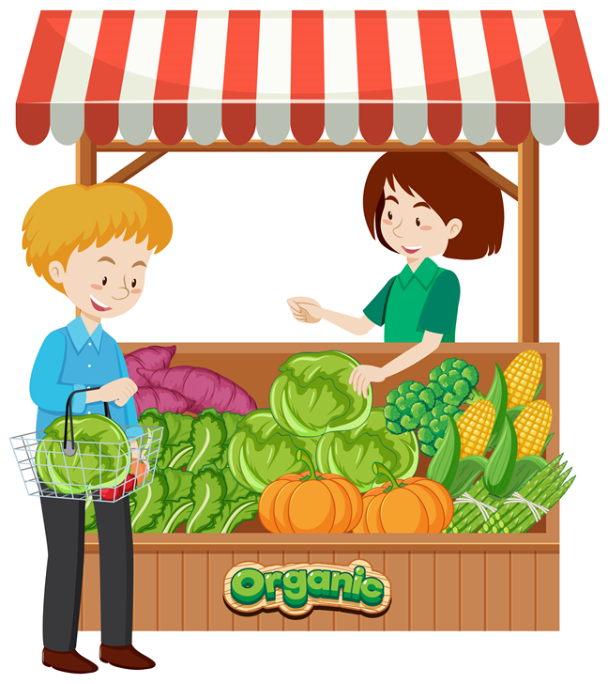
AIM
1
Drawback of Existing System
Project Explanation
Modules
Advantages of Project
DFDs
Technology Used
Requirements
Screenshots
Conclusion
Future Scope
Thank you
2
3
4
5
6
7
8
9
10
11

Slide 3
Drawback of Existing System
Limited reach: If the buying-selling system relies primarily on physical interactions between users and hawkers, it may have a limited reach. Only people who are in close proximity to the hawkers can participate in the system, potentially excluding a larger customer base.
Lack of convenience: Traditional buying-selling systems often require users to physically visit the hawker stalls or markets to make their purchases. This can be inconvenient for customers who may not have the time or means to travel to the locations regularly.
Lack of transparency: The existing system may lack transparency regarding the quality and sourcing of the vegetables. Customers might be unsure about the freshness, organic status, or pesticide usage in the produce they are buying.

Slide 4
Project Explanation
“Veggie Delights” is a Vegetable Selling Web Application online platform, specially designed for helping the Hawkers business, to introduce Hawkers with today’s technology and for users to search and buy fresh vegetables from Hawkers/Vendors.
User-friendly interface for easy navigation and smooth shopping experience.
Detailed product information, including quality, origin, and cultivation methods.
Customized search and filter options to help users find specific vegetables.
Online order booking functionality for users to book vegetables as per his requirements.

Slide 5


Modules
Admin Panel
User Panel
Hawker Panel

Slide 6

Admin - Functionalities
Login
Manage Dashboard
Manage Sub-Category
Manage Products
Manage Users/ Customers
Manage Orders
Manage Order Status
View list of Customers or Hawkers
Logout

Slide 7

User - Functionalities
Register
Login
View Products or Category
Filter Products according to Category and
Sub-Category
Place Orders/ Add to cart
View Order Status
Logout

Slide 8

Hawkers - Functionalities
Register as seller
Login
Add Products to admin
Manage orders(pending/approved/decline/delivered)
View pending Orders
Logout

Slide 9
Advantages
Our vegetable selling platform will increase the productivity of the business since it expands the scalability.
Scaling up the platform to include other grocery items or related products.
Partnering with local farmers and promoting sustainable farming practices.
Collaborating with local communities and organizations to support small-scale farmers.

Slide 10


Data Flow Diagram

Slide 11
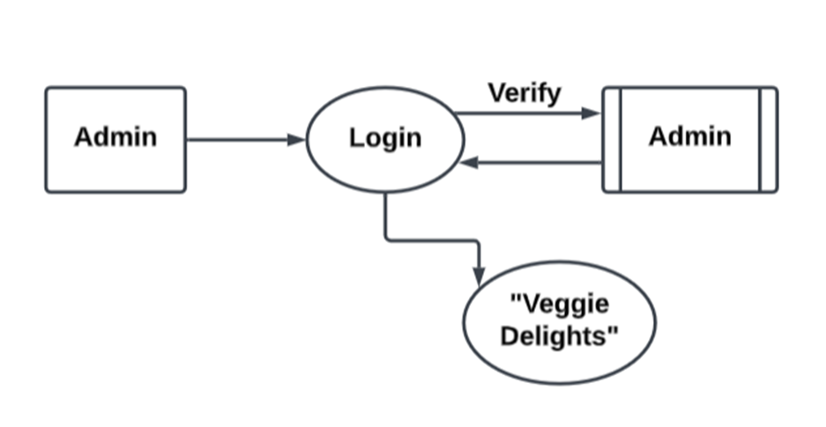
DFD Diagram of Project
Level 0 DFD of Admin Section.

Slide 12
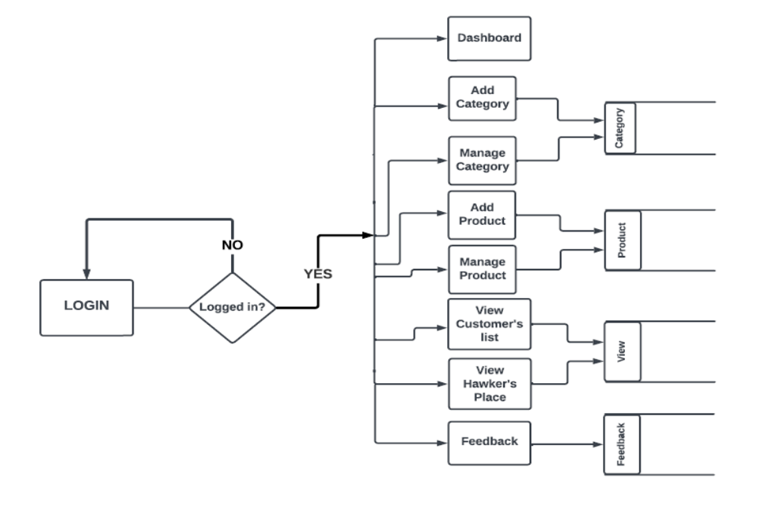
DFD Diagram of Project
Level 1 DFD of Admin Section.

Slide 13
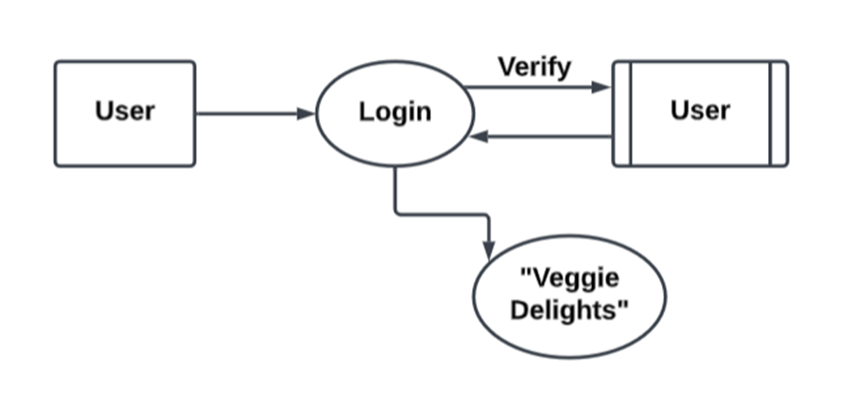
DFD Diagram of Project
Level 0 DFD of User Section.

Slide 14
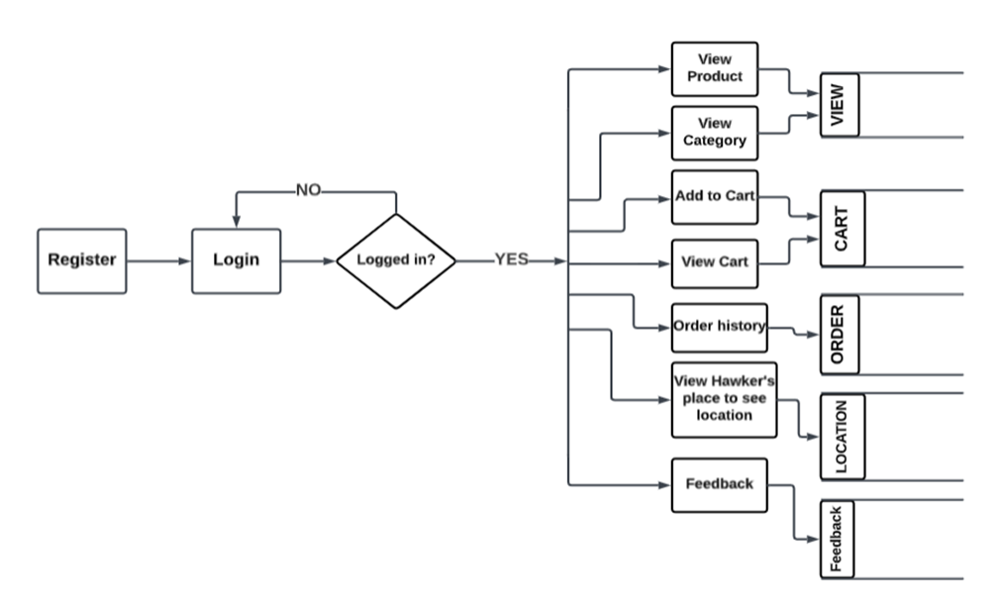
DFD Diagram of Project
Level 1 DFD of User Section.

Slide 15
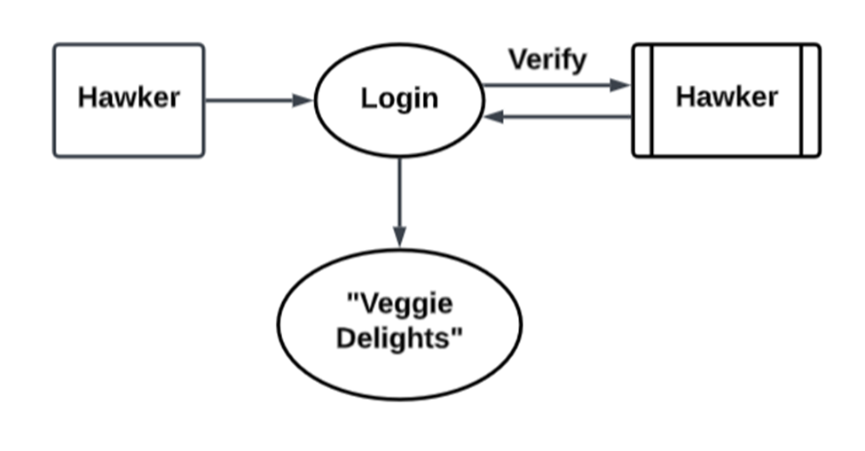
DFD Diagram of Project
Level 0 DFD of Hawker Section.

Slide 16
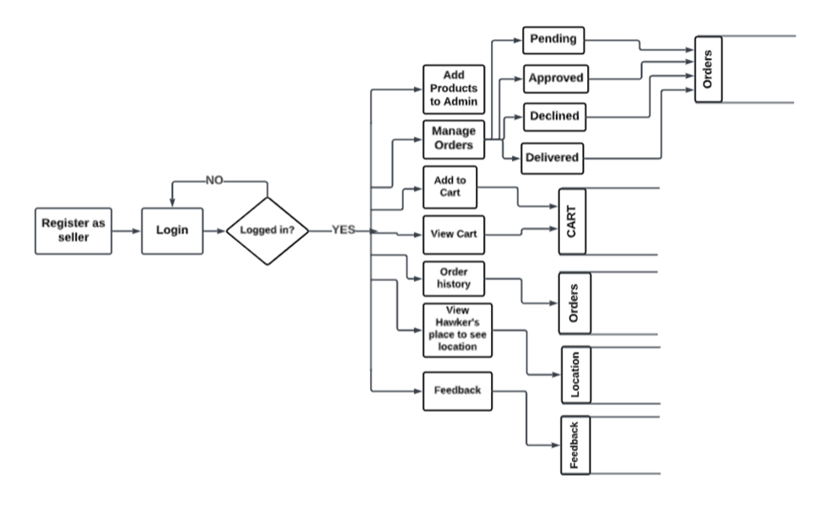
DFD Diagram of Project
Level 1 DFD of Hawker Section.

Slide 17

Technology Used

Slide 18






Front End Technology
HTML
CSS
JAVASCRIPT
BOOTSTRAP
ECMA SCRIPT
REACTJS

Slide 19

Back End Technology
Firebase & Firestore

Slide 20
Hardware & Software Requirements
Hardware Requirement
Software Requirement
Front End Tool :
DB Tool :
Environment :
Back End Tool :
Browser :
Operating System :
HTML, CSS, Bootstrap, JavaScript, ECMA Script, ReactJS
Processor : Intel I3
RAM : 8.00GB
SSD : 256 GB
FireStore
Firebase
Visual Studio
Mozilla Firefox/Chrome/ Edge
Windows Operating System / Linux

Slide 21

Screen
Shots

Slide 22
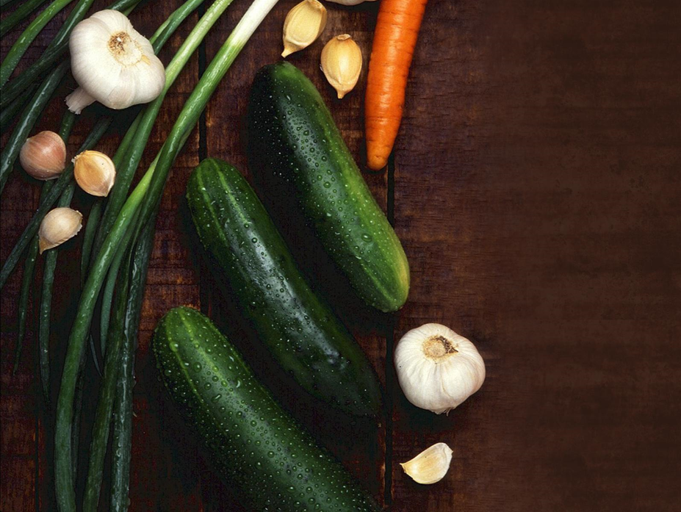
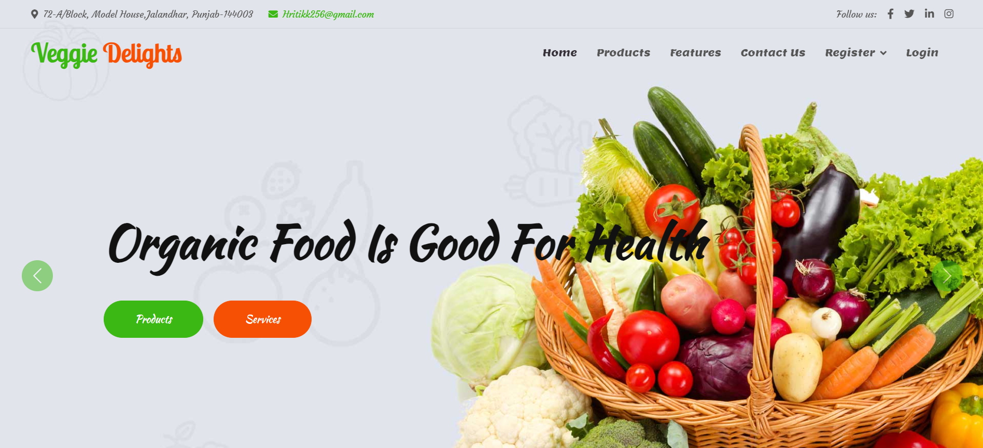
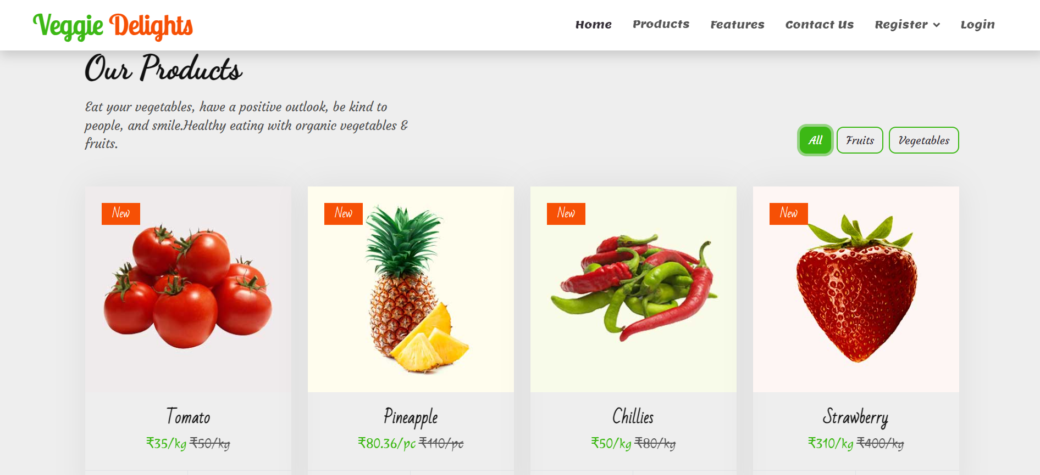
Home Section

Slide 23
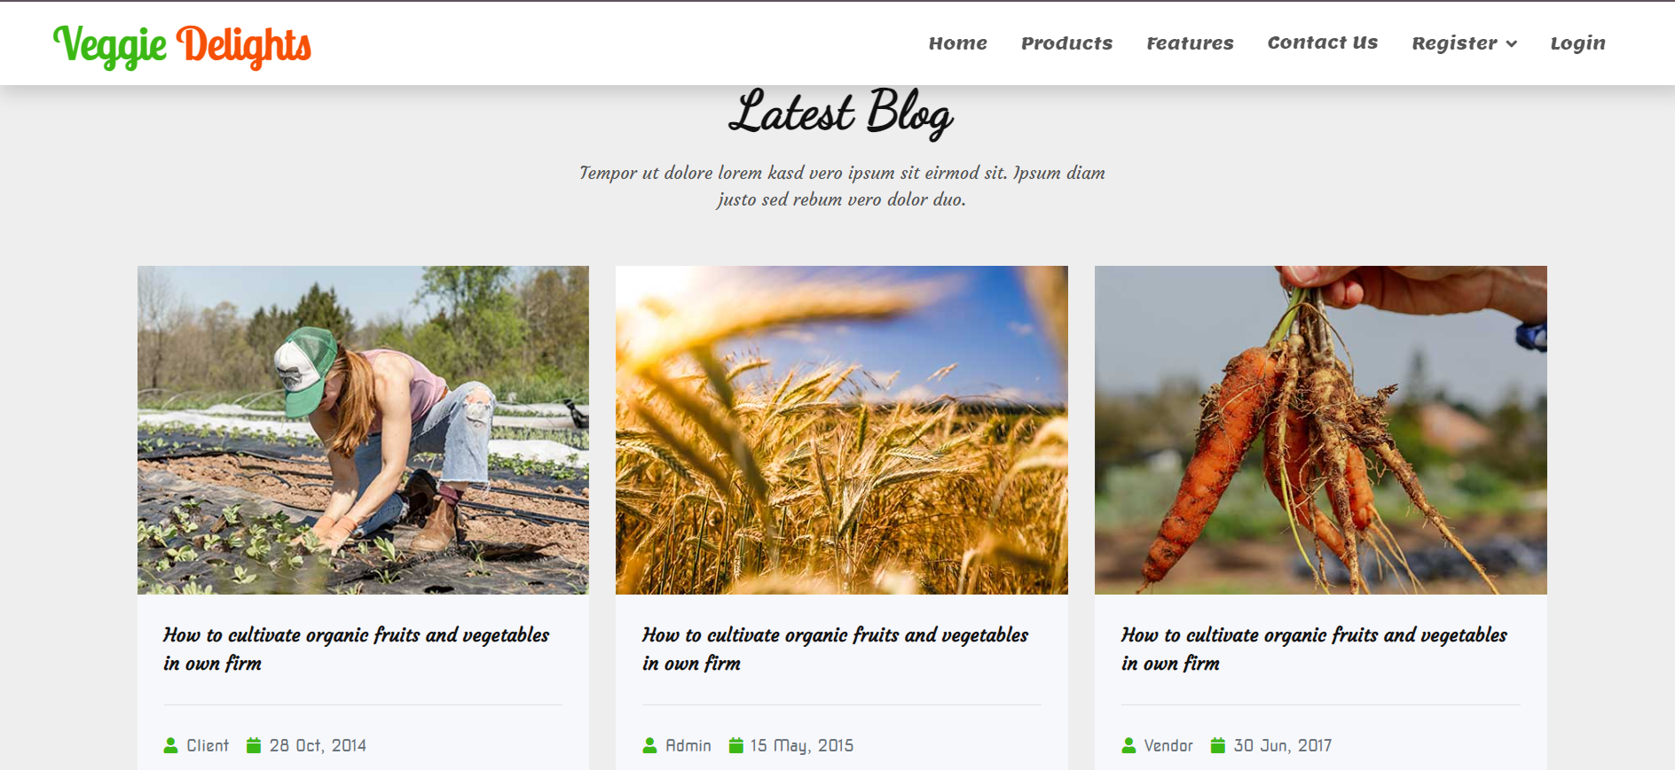
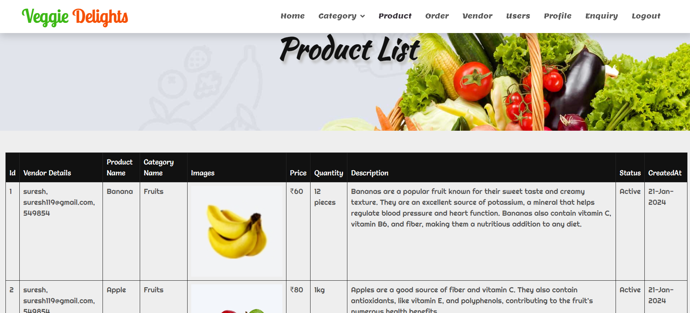
Product Section

Slide 24
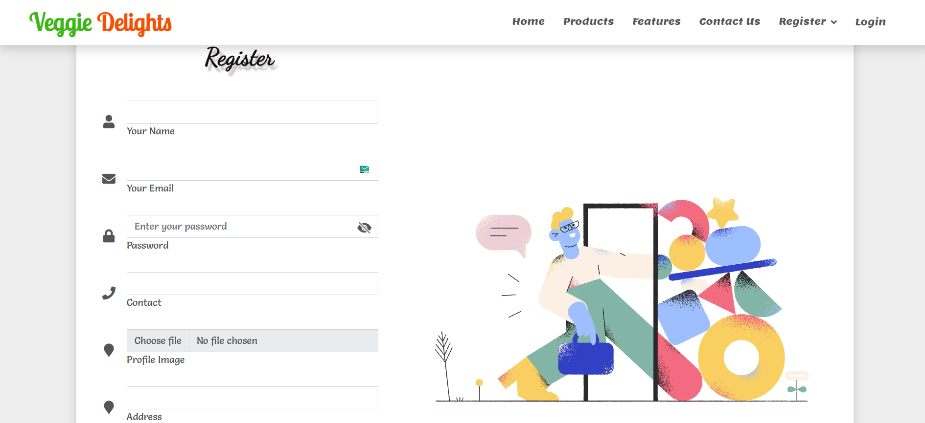
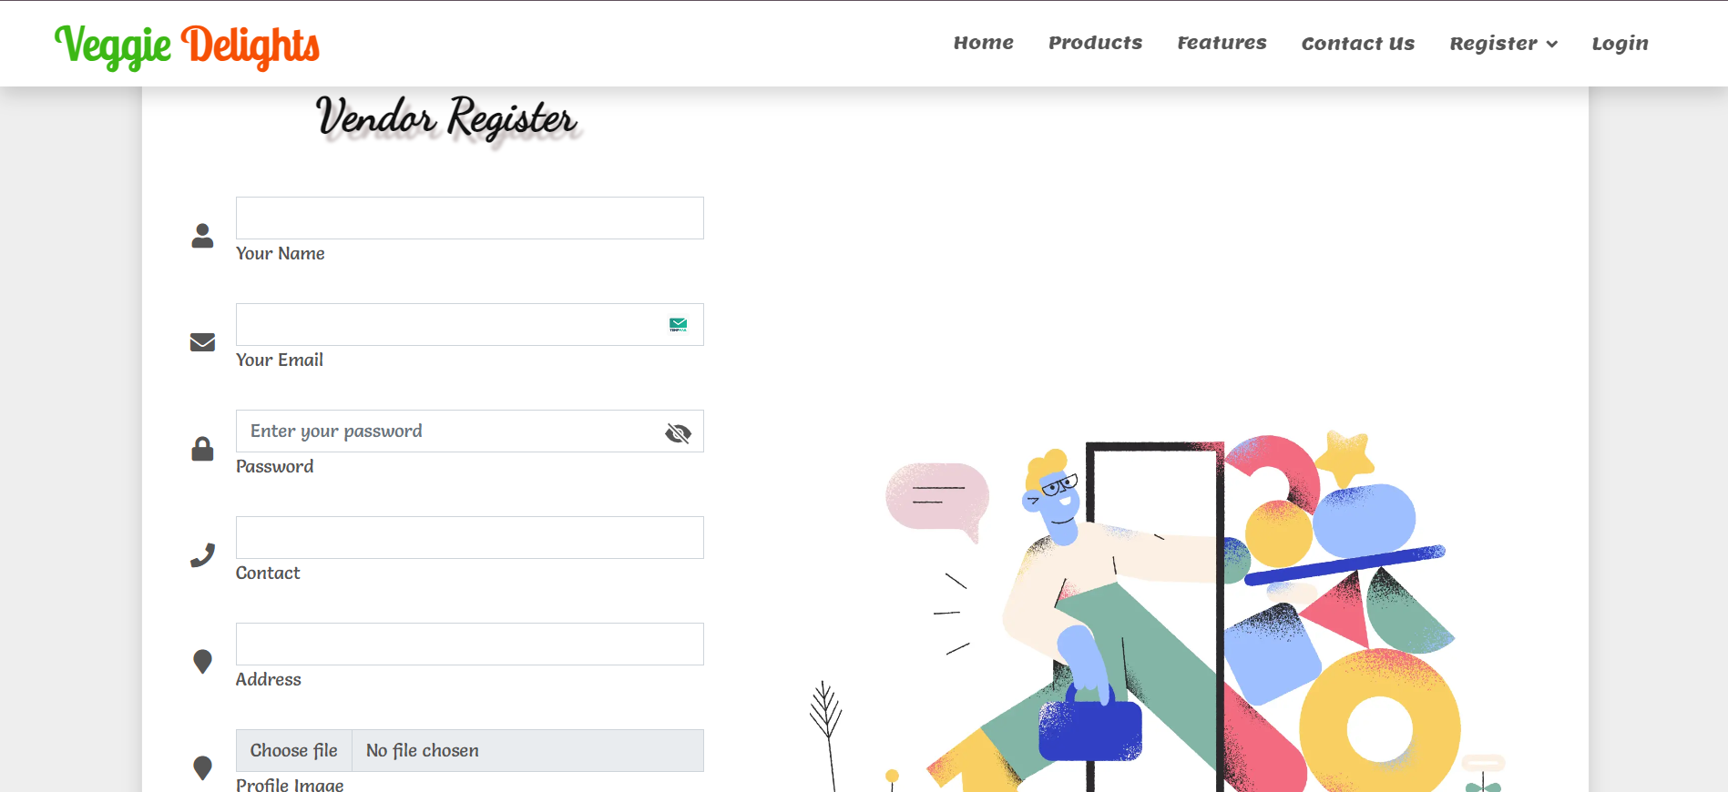
Register Section

Slide 25
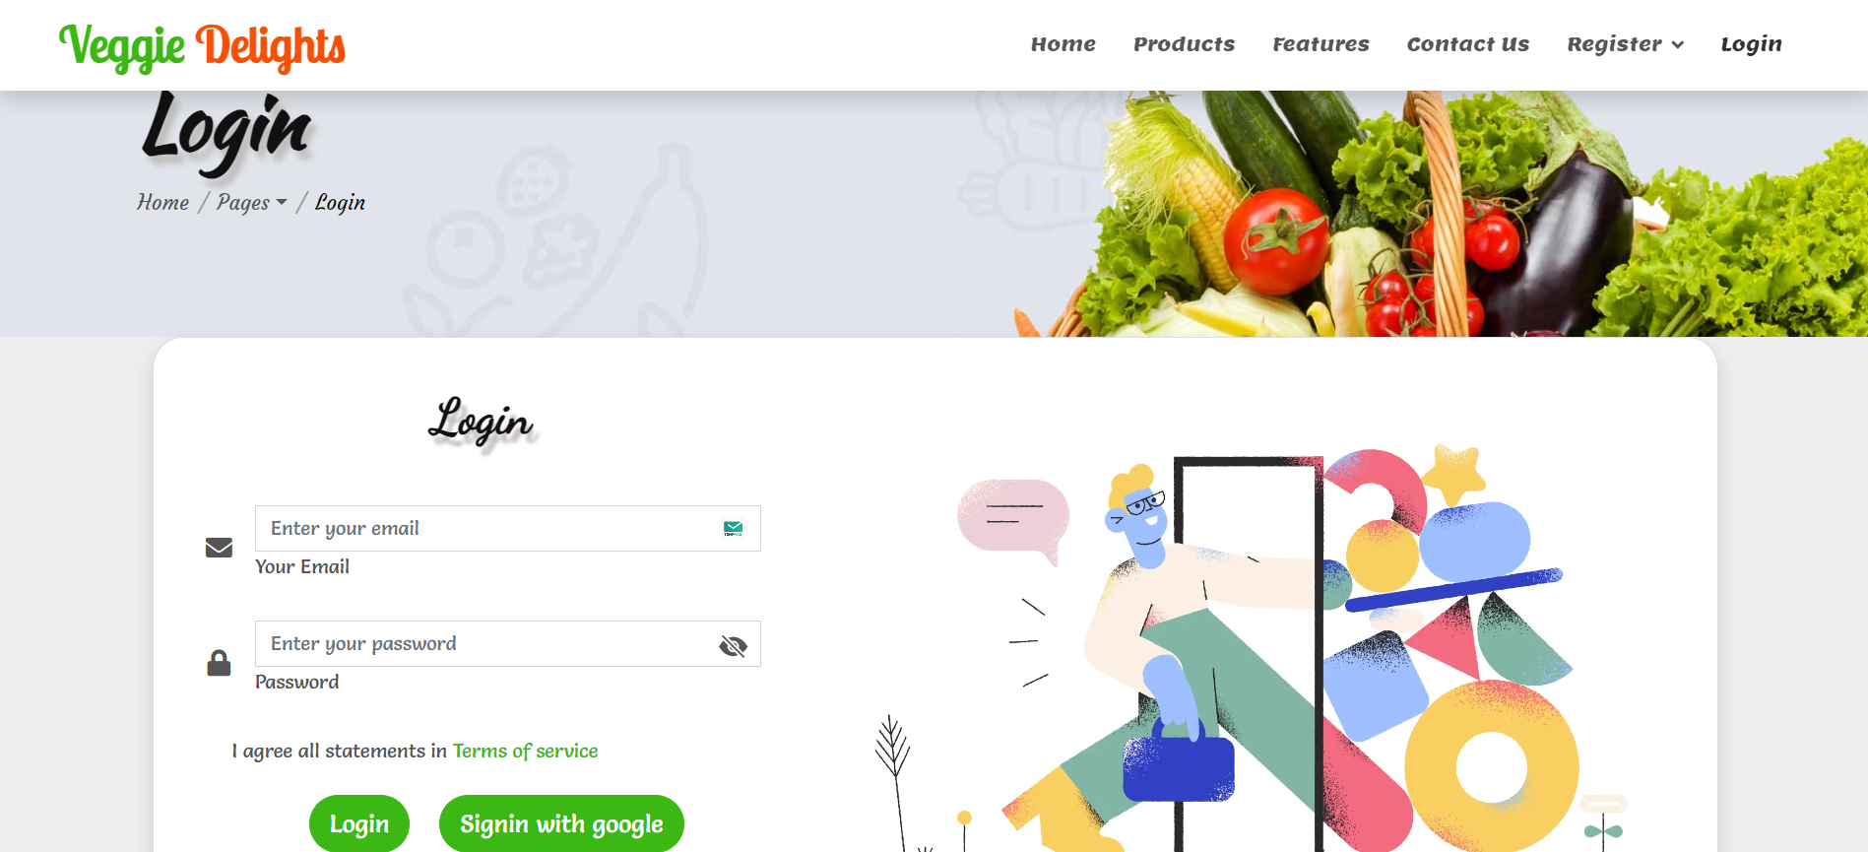
Login Section

Slide 26
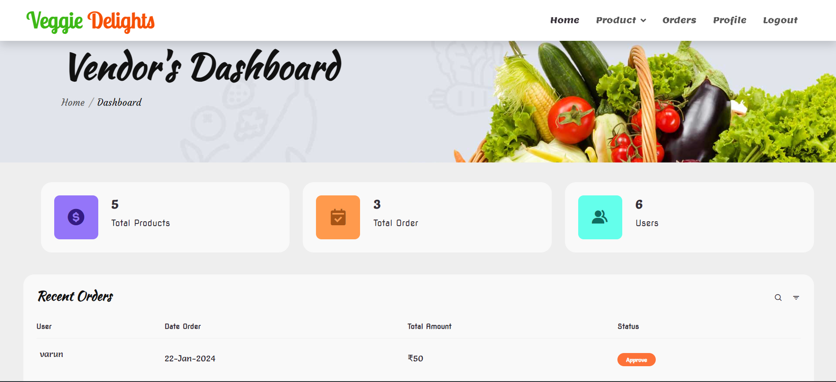
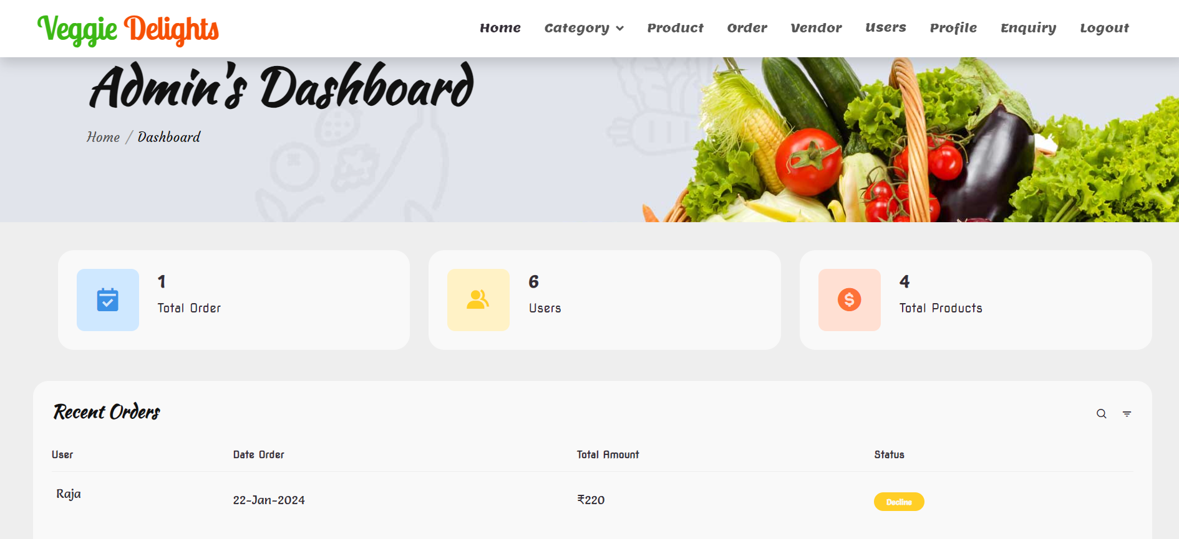
Dashboard Section

Slide 27
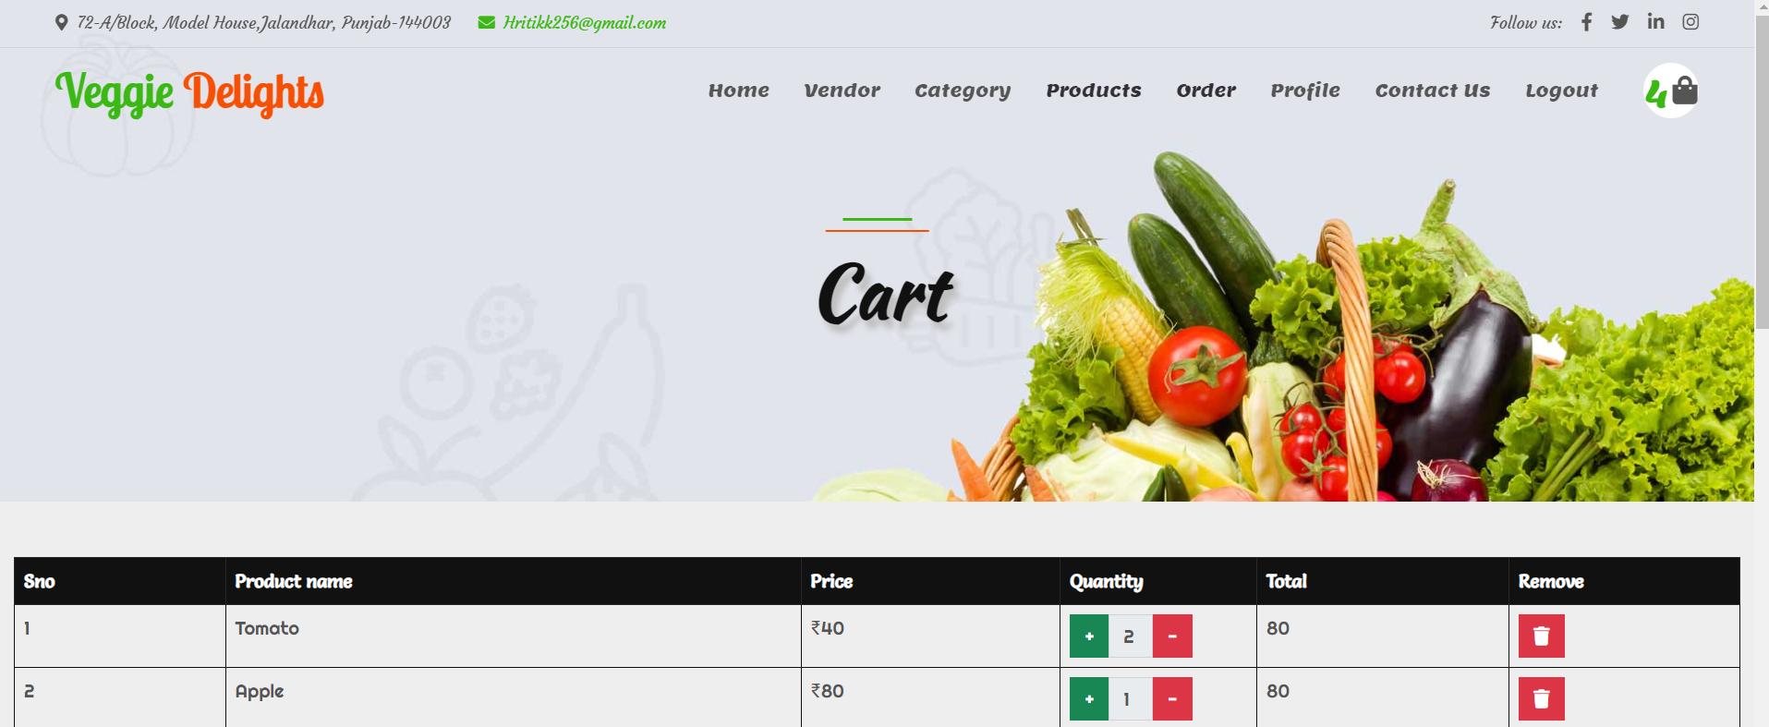
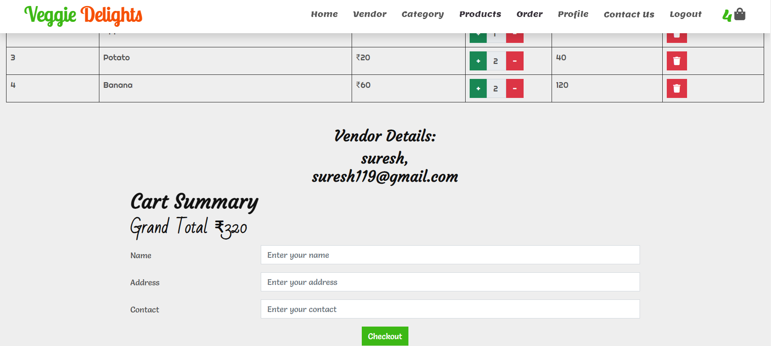
My Cart Section

Slide 28
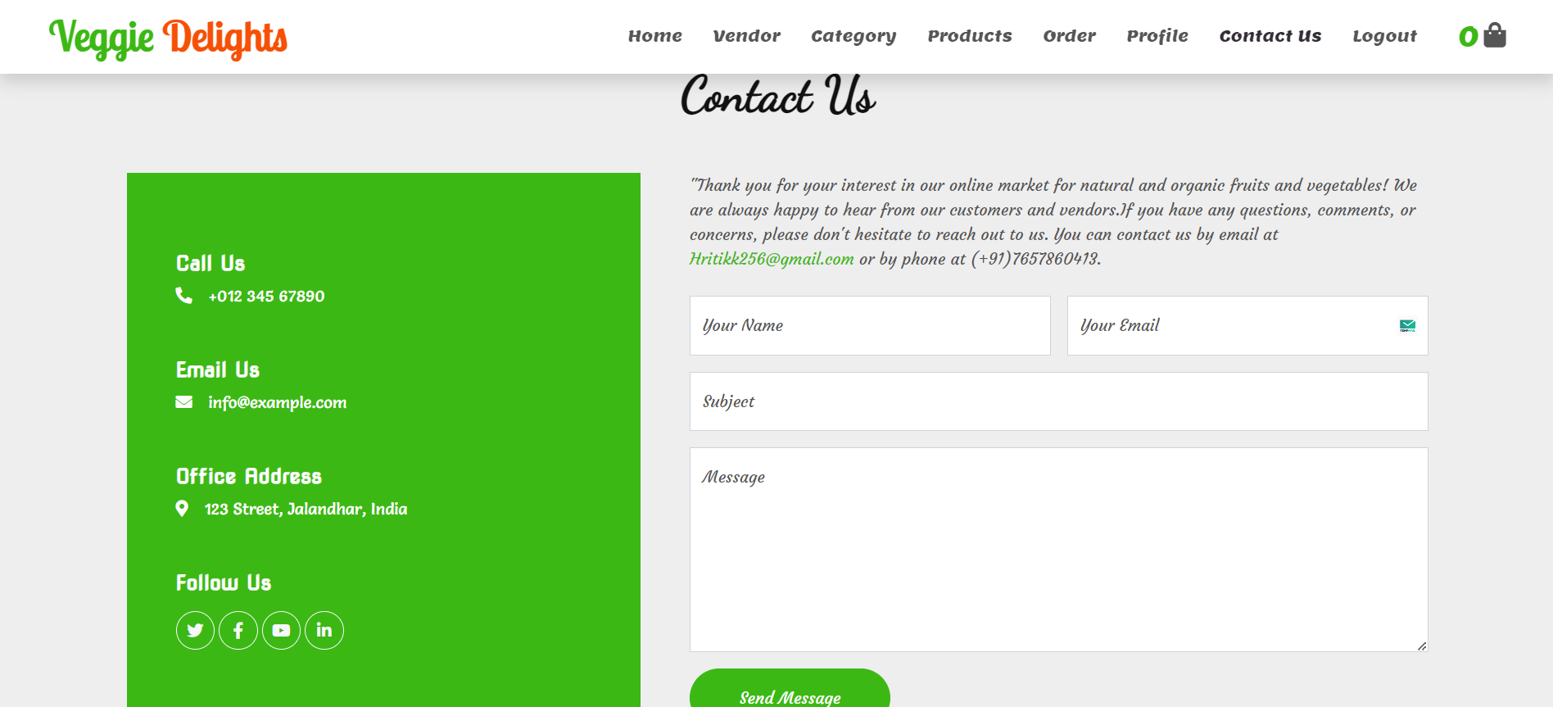
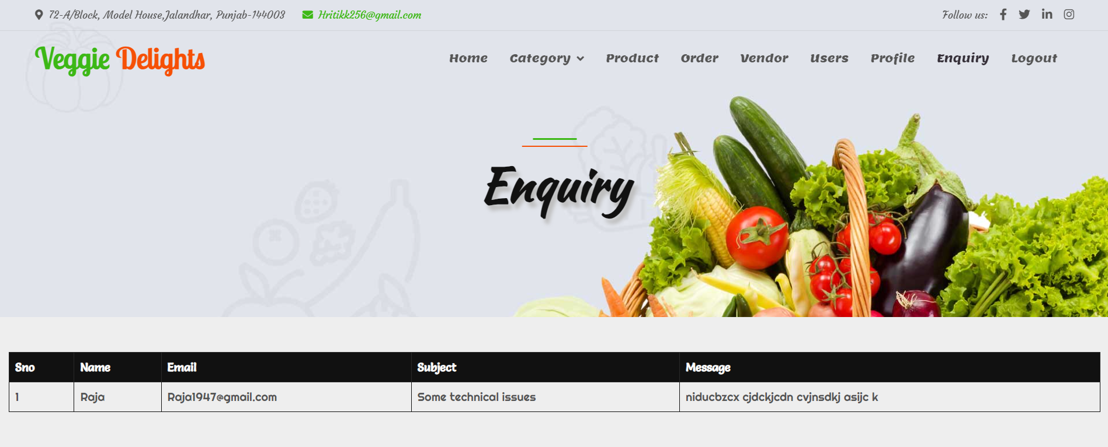
ContactUs Section

Slide 29
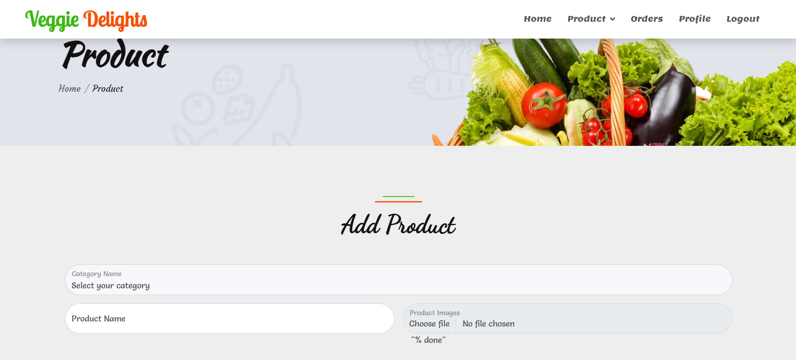
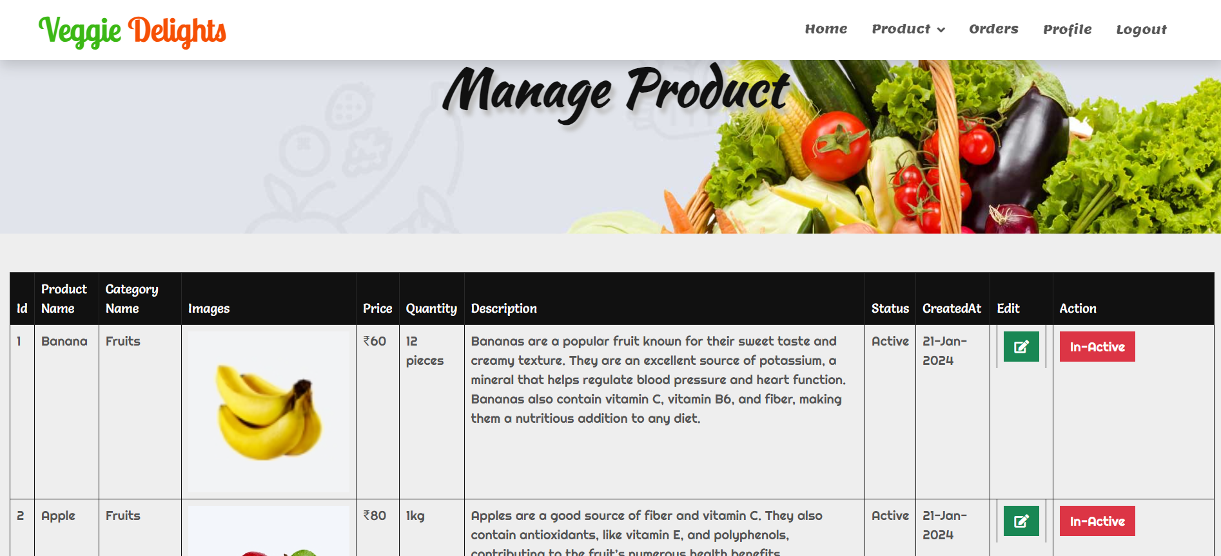
Add & Manage Product

Slide 30
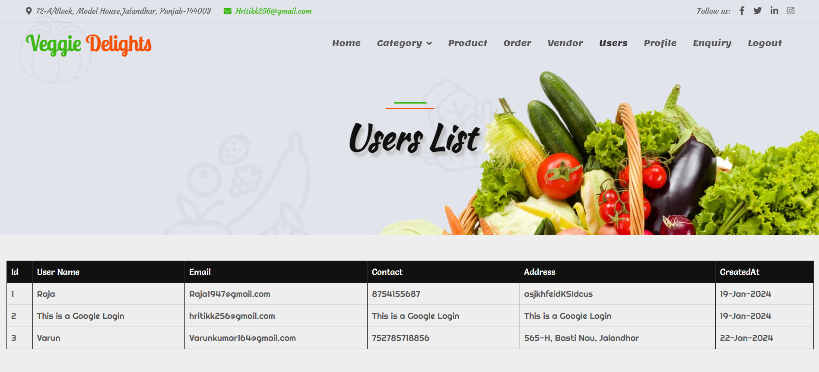
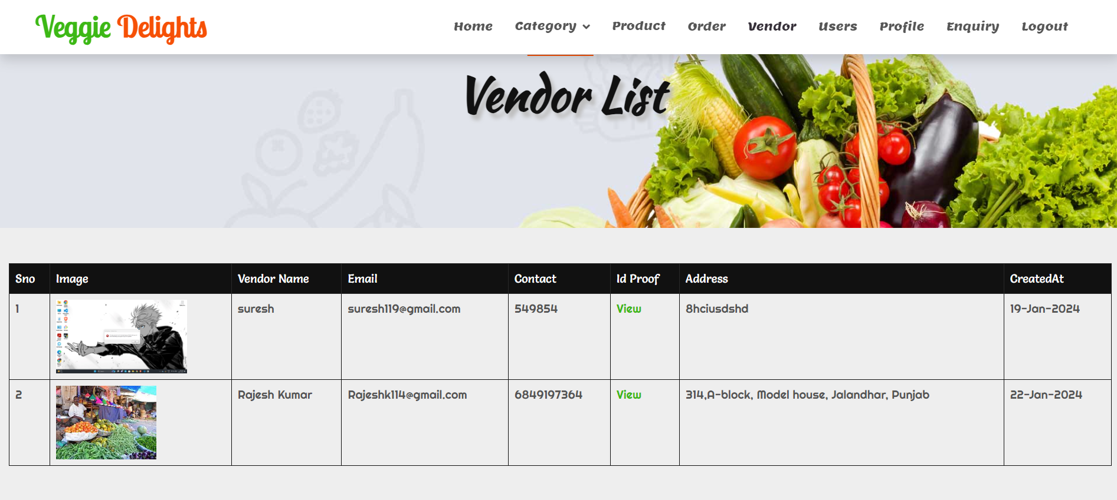
Users & Vendors List

Slide 31
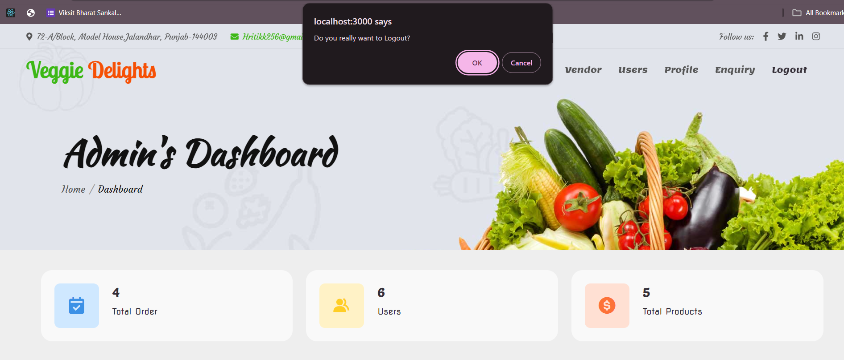
Logout

Slide 32
Conclusion
Our vegetable selling application brings together the needs of both users and hawkers/vendors, revolutionizing the way vegetables are bought and sold.
Online shopping is time saving specially for the working people.
This online platform increases the scalability of the vegetable business.
User can browse through a wide range of fresh and diverse vegetables, access detailed product information, read reviews.
Customers get multiple options for the same product.

Slide 33

Future Work
This application can offer a wider range of vegetables and cater to a larger customer base.
Collaborating with local farmers can provide a direct source of fresh produce for hawkers/vendors. This partnership can ensure a steady supply of high-quality vegetables while supporting local agricultural communities.
Developing additional tools and features specifically for hawkers/vendors can boost their productivity and sales.

Slide 34
THANK YOU

